Slide 1
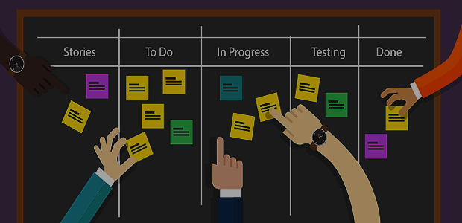
Scrum-agile And ChadaTech
A new way forward for our company?

Slide 2
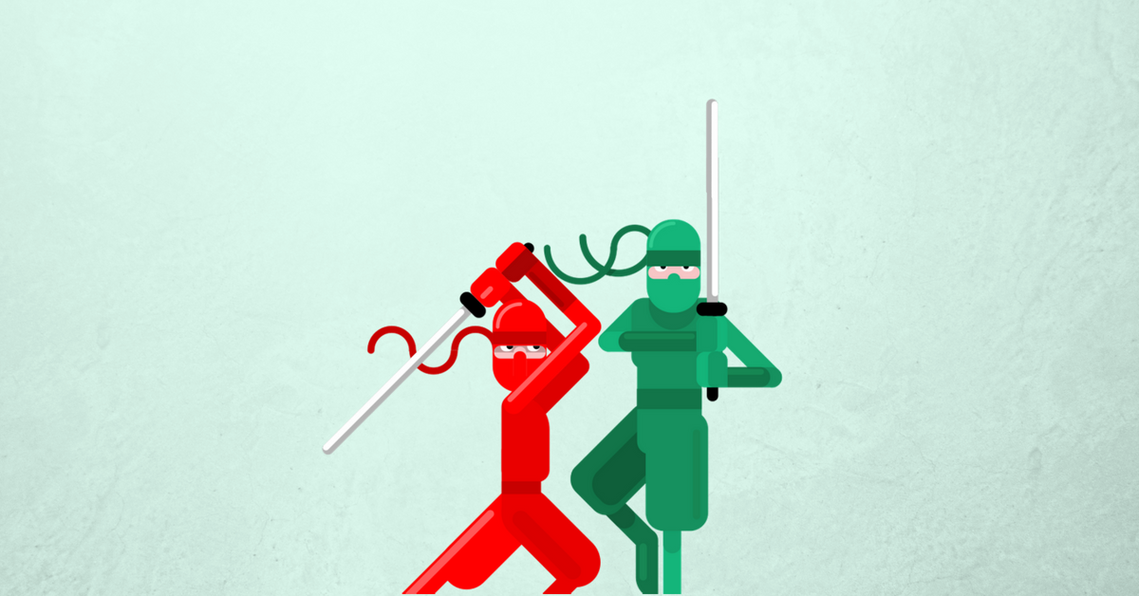
Product Owner
Scrum Master
Highest level of ownership
Creates and manages product backlog
Liaison between end-user and development team
Sets backlog priorities
Develops user stories
Bridges technical gap from idea to product.
Pursues Business Value and steers team towards that end
Facilitates Scrum events such as stand-up
Mentors Development team
Designated Door Kicker
Removes Roadblocks, hurdles and bottlenecks
Conducts Sprint Planning with team
Conducts Sprint Reviews and Retrospectives
Promotes trust and collaboration
Fosters learning from failure rather than loosing from it

Slide 3


Slide 4

Development Team
Develops programs from user stories
Builds UI/UX for end users
Creates algorithms to solve problems
Documents code with explanations
Turns a plan into action
Shares expertise with team members
Learns from other team members
Develops test cases from user stories
Builds Regression testing suites
Collaborates for bug fixes
Builds automated testing modules
Performs Quality Verification
Ensures definition of done reached
Seeks clarification of requirements

Slide 5


Team Roles
Product Owner
The product Owner maximizes value of a product and manages the product backlog including creating user stories. Effectively the Product Owner is the accountable party for the project and is expected to “own” the product and the development team. The team’s success or failure directly falls on the Product Owners shoulders.
Scrum Master
The Scrum Master ensures Scrum is understood and enacted. The Scrum Master assists the Product Owner with the product backlog, helps the team understand items on that backlog, organizes and facilitates Scrum events, and helps train, mentor and coach the development team. In a sense, the Scrum Masters’ job is to remove the need for a Scrum Master in most circumstances.
Development Team Members
The Development team is self organizing and focuses on how to turn the product backlog into product iterations. There are no sub-teams or defined roles in a development team. At the end of the day team members may have different skills and specialties but the entire development team is responsible and accountable for the project. Development teams are expected to be cross-functional and collaborate to achieve goals.

Slide 6
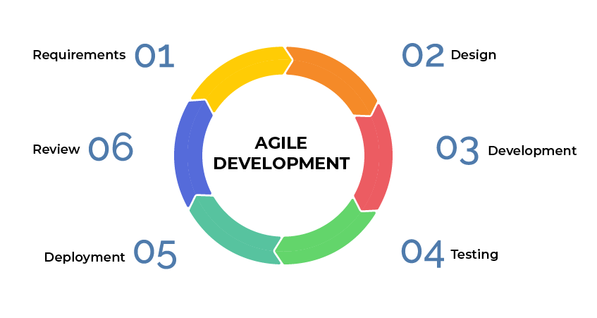
Agile Development Lifecycle
Step 1: Determine the requirements:
First you determine a baseline set of requirements for a project or iteration, the minimum viable product/ “done”.
Step 2: Design the software:
Create a rough mockup of the UI/UX (if applicable) and team determines what technologies, frameworks, libraries and languages will be used for the project.
Step 3: Develop:
Develop the software, convert design documents and planning into working software, complete sprints and iterations of done.
Step 4: Integration and Testing:
Ensure the project is bug free using developed automated and regression testing along with manual checks, this is quality verification time.
Step 5: Deploy the product:
Whether its live or a demo, this is where the product goes to end users. Here the product receives feedback.
The Agile Software Development Lifecycle in a graphic
“With Scrum, a product is built in a series of iterations called sprints that break down big, complex projects into bite-sized pieces,“-Megan Cook, Atlassian
Step 6: Review:
Review the process and feedback, determine what went wrong and what went write and find ways to improve on the process. Start the cycle again.

Slide 7
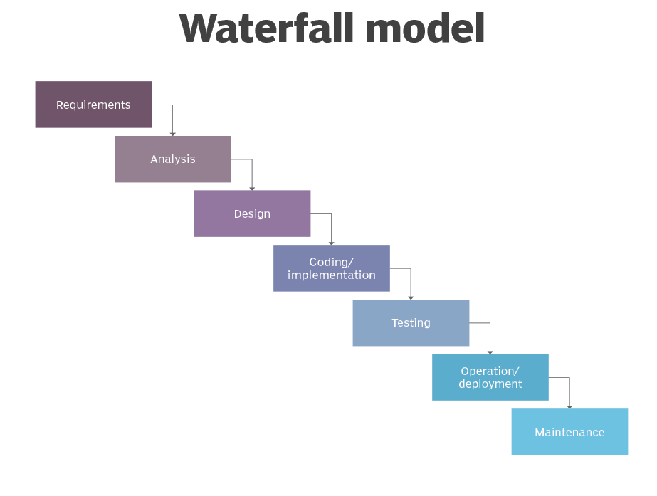
Waterfall model refresher
Just as a refreshed this is the waterfall method.
Notice the linear design of the waterfall method. This is how a typical
waterfall method is handled, as a linear project. This means the requirements
must be flushed out completely in the beginning of the project, every feature and
design portion must be thought of. From there you build the team and determine
the technology stacks you will use. Then, you get to coding and implementation where
you build all features, making the entire project from start to finish. Finally, you test the
project to the best of your abilities, try to flush out every bug you and when you are confident you deploy it to the end user. Any changes in requirements could require you to restart the entire process.

Slide 8
Waterfall in the SNHU Travel Project
In the case of the SNHU Travel project, if we were using the waterfall method, we would have had to sufficiently flush out the details of the project before we started. In our case the requirements of the project changed several times, and we would have had to know exactly what the end goal was before we could begin development without major time losses. When the project changed from a single page to slide display style, we may have had to refactor some code but would not necessarily needed to restart the project. When the project then changed to focus on “Detox and Wellness” we likely would have had to spend weeks refactoring as each trip would need additional considerations and those considerations would have needed to been factored into the entire design. With the waterfall process we would likely need to go back and update the design document and consider the possible ramifications on the overall project. Any features we added during the process would need new testing considerations as well. Finally, we would have had to spend a significant portion of time testing at the end and doing bug fixes to ensure our product worked on deployment. I think it is likely we would have missed the deadline or would have deployed a substandard product

Slide 9
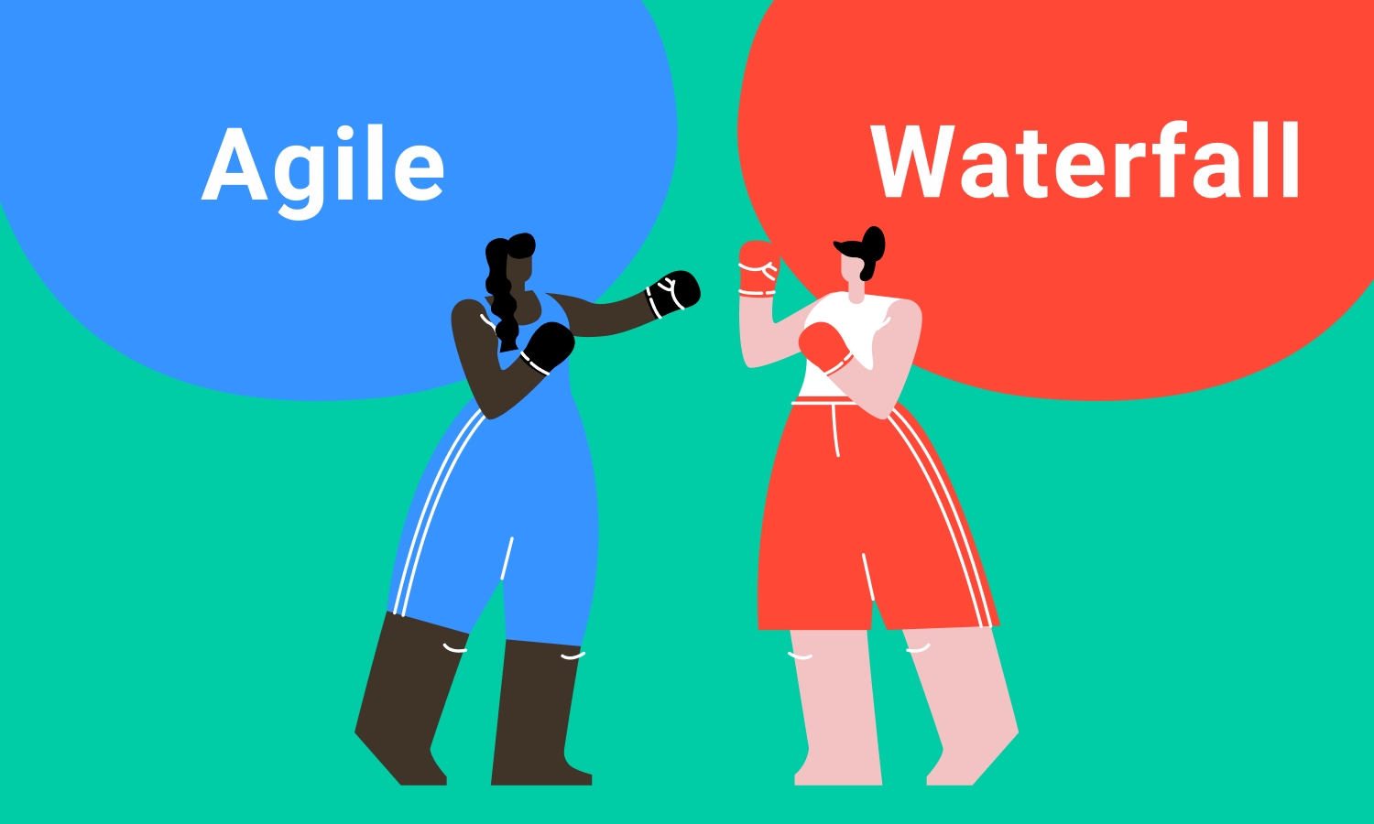
VS
Agile is great for some common software development projects. Agile is the perfect method for rapidly changing or proof of concept projects. If you want your product to be deployed fast, receive immediate feedback, and can build upon your project until you find its state satisfactory then agile is the obvious choice.
Waterfall is an older but still relevant method of software development in modern day projects. If your project needs to be done on arrival, has limited if any major changing requirements, or will depend on security and stability over rapid deployment then waterfall may be right for your project. A great example of a waterfall (ideal) project would be a mobile banking app or website, a securities database, cryptocurrency wallet, software on a classified network that can touch web facing networks.
At the end of the day, you need to use the best tool for the job, not choose a tool and use it for every job. The factors you need to consider when deciding whether to use an agile or waterfall approach are numerous, but I will list a few that came into play during the SNHU Travel project. First, how flushed out is your idea and how firm are you in that idea? If you know product requirements are not going to change and the product will be launched as conceptualized, waterfall may be your best option. Next, how important is speed, meeting changing demands, and feedback compared to stability and security. This is not to say agile development is insecure, but in an agile sprint cycle a product can not be tested for every possible flaw prior to deployment in many cases. Finally, the last factor I would consider is reputation and its important, its one thing to launch a buggy application as a start up, but that same buggy app may destroy the reputation of a company like JP Morgan Chase, or EA.

Slide 10
References
Slide 5: Scrum Roles, Charles G. Cobb. (2015). The Project Manager’s Guide to Mastering Agile : Principles and Practices for an Adaptive Approach. Wiley.
‌Slide 6: Megan Cook, Atlassian. (2021). Sprints | Atlassian. Atlassian. https://www.atlassian.com/agile/scrum/sprints
Slide 6: Ihor Feoktistov. (2020, November 9). Agile Software Development Lifecycle Phases Explained. Relevant Software; Relevant Software. https://relevant.software/blog/agile-software-development-lifecycle-phases-explained/
Slide 9: Maria, J. (2020, August 12). Agile vs. Waterfall | Software Development Methodologies. Project-Management.com. https://project-management.com/agile-vs-waterfall/#:~:text=Agile%20is%20an%20incremental%20and,helps%20complete%20one%20single%20project.

